Slide 1

Movie Recommendation System
Information Retrieval Project by Soumya Baddham & Kalyan Ram Machineni

Slide 2
Agenda:
Why Recommendation System?
Types of Recommendation Systems
Content Based Filtering
Architecture
Methodology
Demo
Future Work

Slide 3
Why Recommendation System ?
With so much information available on the internet, users are overwhelmed by the amount of the data. Recommendation systems help users to discover relevant content.
Improved User Experience and Engagement
Revenue Generation: Recommendation systems can also be used to generate revenue by promoting products and services that are likely to be of interest to users.

Slide 4
Types of Recommendation Systems:
Content Based Filtering
Collaborative Filtering
Hybrid Approach

Slide 5
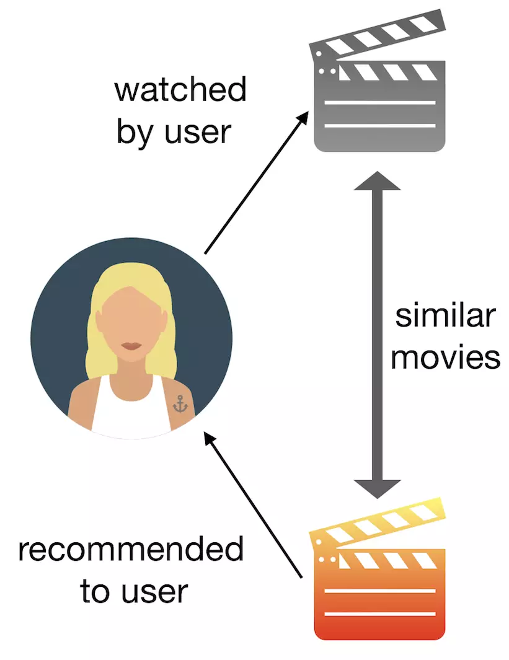
Content Based Filtering
Content-based filtering is a type of recommendation system that involves analyzing the properties or characteristics of an item (such as a movie, book, or product) and recommending other items that have similar properties or characteristics.

Slide 6
Architecture:
Content-based Filtering generally converts text into vectors and calculates the similarity between vectors. In our project we built two such algorithms to recommend movies.
Algorithm 1:Get Movie Recommendations using tf-idf vectorizer and cosine similarity
Algorithm 2: Get Movie Recommendations on basis of intersection between documents and cosine similarity

Slide 7
Methodology :
Data Preprocessing
Feature Extraction
Similarity Calculation
Movie Recommendation

Slide 8
Data Preprocessing
We have used ‘TMDB 5000 Movie dataset’ for this project, which includes information such as movie titles, genres, keywords, popularity and tagline.
We first preprocessed the movie dataset by removing punctuations, converting text to lowercase, and removing common stop words (such as 'the', 'and', 'in') from the text data.
‘csv` library: To read and process the movie dataset stored in a CSV file.

Slide 9
Feature Extraction:
For each movie, we combined several preprocessed textual features, then tokenized the combined text, which creates a set of unique words for each movie, which are then vectorized using tf-idf.
Similarity Calculation:
We measure the similarity between movies by using cosine similarity metric. This metric considers the shared terms(i.e., intersection) between two movie sets and the total number of terms in each set. Cosine similarity ranges from 0 to 1, with 1 being the highest similarity possible.

Slide 10
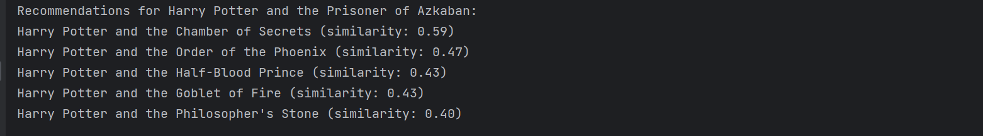
Movie Recommendation :
For given input movie ID, we find the top 5 most similar movies in the dataset by comparing the cosine similarity of their combined features. We then present these recommendations along with their similarity scores.

Slide 11
DEMO

Slide 12
Future Work:
Creating a User Interface for Recommendation System
Will try to Implement a Recommendation System which retrieves common movie names using both algorithms

Slide 13


